Slide 1


Final Year Project
Tumor Vision
Supervised By: ishtiaq Ali (Lecturer)

Slide 2
Project Team
Syed Sibt E Hassan Kazmi (38252)
Khalid Bin Waleed (35777)

Slide 3
Table of Content
Introduction and Background
Literature Review and Summary Table
Problem Statement
Methodology
Progress Report Summary
Requirements
Software System (Design + Implementation + Testing)
Endeavour (Team)
Next Steps
Prototype / Report

Slide 4
INTRODUCTION AND BACKGROUND

Slide 5
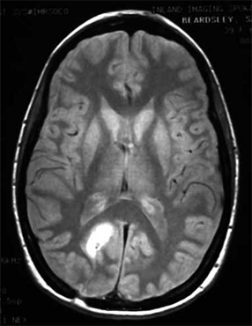
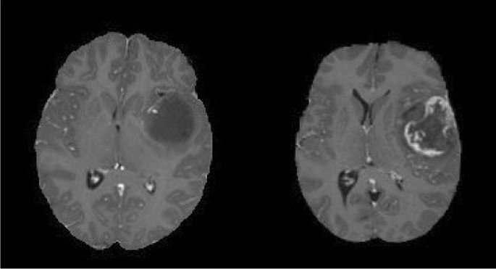
Introduction [1/4]
Brain tumors are abnormal and potentially life-threatening cell growths in the brain or central nervous system.
MRI is the most effective imaging method for brain tumor detection.
Brain tumors make up 1.6% of global cancers with over 321,000 cases (WHO)
Common types include Glioma, Meningioma, Pituitary tumors.
Figure 1

Slide 6
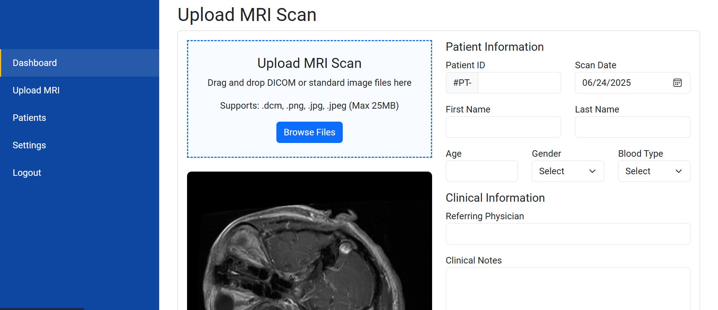
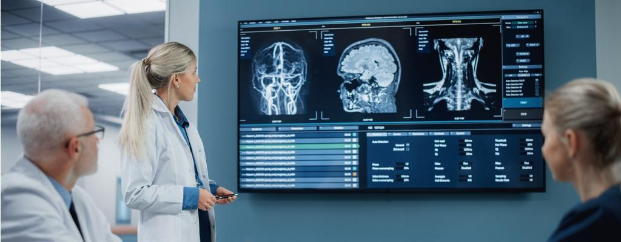
Introduction [2/4]
Two Types of Diagnosis Methods:
Traditional in-person radiologist review
AI-based automated detection systems
Figure 2. Traditional
Figure 3. AI-based

Slide 7
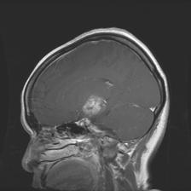

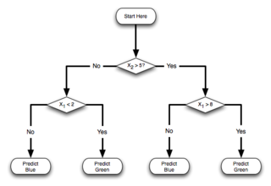
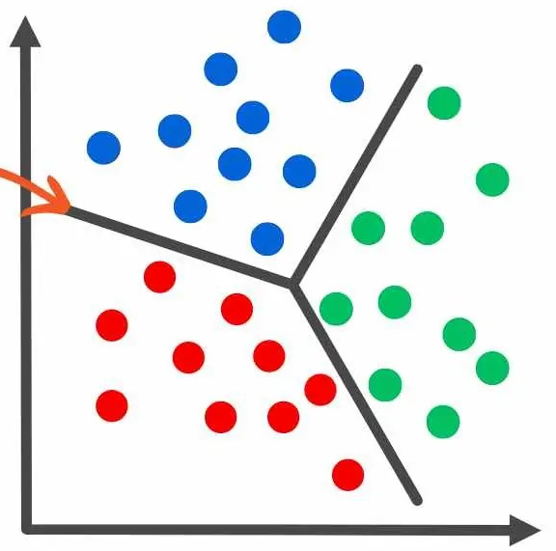
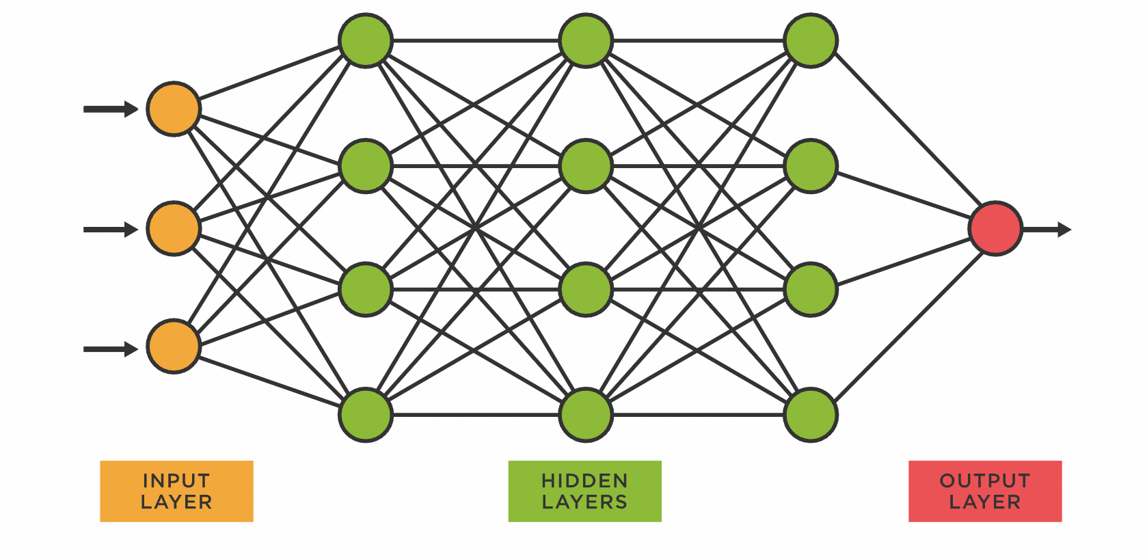
Introduction [3/4]
Vision-Based Brain Tumor Detection Approaches:
Handcrafted Features + ML classifiers (e.g., SVM, Random Forest)
Deep Learning (CNN) models like DenseNet, ResNet, using automatic feature extraction + softmax classification.
Machine Learning
Glioma
Input
Manual Feature
Extraction
Result
Classification
Deep Learning
Glioma
Input
Feature Extraction + Classification
Result
Figure 4. ML Vs DL techniques

Slide 8
Introduction [4/4]
Challenges:
Intra-class variation: Tumors of the same class may look different.
Inter-class similarity: Tumors from different classes may look visually similar.
Low contrast: MRI scans can have noise or low visual contrast.
Data imbalance: Rare tumor types are underrepresented in datasets.

Slide 9
LITERATURE REVIEW

Slide 10
Literature Review[1/4]
(Sen et al., 2022)[1] developed a brain tumor classification system using deep CNNs with transfer learning. They applied preprocessing techniques like skull stripping and BM3D denoising on MRI images from four tumor classes. Among several pretrained models, EfficientNetB0 achieved the highest accuracy of 97.61%, showing that modern CNNs with proper preprocessing greatly enhance classification performance.
(Aamir et al., 2024)[2] proposed a hyperparameter-optimized CNN for brain tumor classification using MRI scans. By fine-tuning parameters like learning rate, filter size, and dropout, their model achieved 97.18% accuracy with strong precision, recall, and F1-score (~97%) on a 4-class dataset. The study emphasizes that effective hyperparameter tuning greatly improves diagnostic accuracy.

Slide 11
Literature Review[2/4]
(Tummala, 2023)[3] used an Inception-ResNet model to classify brain tumors from 5,952 MRI images across four classes. With preprocessing and hyperparameter tuning, the model achieved 96.7% accuracy, performing well on most classes but showing lower sensitivity for meningioma due to class imbalance. The study shows that pretrained deep networks can effectively support automated brain tumor diagnosis.
(Kumar & Kumar, 2022)[4] developed a custom 25-layer CNN for brain tumor classification and segmentation using T1-weighted MRI images. Trained on 3,580 images across three tumor types, the model used extensive preprocessing and achieved 81.6% testing accuracy with the Adam optimizer. It outperformed models like AlexNet and ResNet50, highlighting the strength of custom architectures with proper training strategies.

Slide 12
Literature Review[3/4]
(Nawaz et al., 2022)[5] introduced a hybrid brain tumor classification (HBTC) method using texture-based features from T2-weighted MRI scans. After preprocessing and segmentation, key features were extracted and reduced from 245 to 9 using optimization techniques. Among several classifiers tested, MLP achieved 98.3% accuracy, showing strong performance in classifying four tumor types with high precision.

Slide 13
Literature Review[4/4]
Table 1
Paper No. | Citation | Dataset Size | Classifier Used | Accuracy
1 | (Sen et al., 2022) | 3,264 | EfficientNetB0 | 97.61%
2 | (Aamir et al., 2024) | 7,023 | Optimized CNN (custom model) | 97.18%
3 | (Tummala, 2023) | 5,952 | Inception-ResNet | 96.70%
4 | (Kumar & Kumar, 2022) | 3,580 | 25-layer custom CNN (Adam, SGDM optimizers) | 81.6%
5 | (Nawaz et al., 2022) | 1,000 | MLP, J48, Meta Bagging, Random Tree (RT) | 98.3%

Slide 14
Research Gap Analysis

Slide 15
Table 2. Research Gap Analysis
Paper No | Citation | Strengths | Limitations / Gaps
1 | (Sen et al., 2022) | Used multiple pretrained CNN models; achieved high accuracy (EfficientNetB0: 97.61%) | Lacked detailed segmentation stage; limited to classification only; did not test on cross-dataset generalization
2 | (Aamir et al., 2024) | Developed optimized CNN with fine-tuned hyperparameters; tested on multiple datasets | Limited model generalization to unseen datasets; requires high computational resources; lacks segmentation
3 | (Tummala, 2023) | Applied pretrained Inception-ResNet; used image augmentation to reduce overfitting | Performance lower for rare classes (e.g., meningioma); limited dataset variety; no segmentation or patient report generation
4 | (Kumar & Kumar, 2022) | Proposed a custom 25-layer CNN; included segmentation; applied image augmentation and optimizer comparison | Moderate testing accuracy (81.6%); limited class diversity; no real-time testing or end-to-end deployment pipeline
5 | (Nawaz et al., 2022) | Introduced HBTC framework with hybrid feature extraction and optimization; tested multiple classifiers; achieved 98.3% accuracy | Traditional ML approach; lacks deep learning or real-time processing; segmentation method (TACS) relatively basic

Slide 16
PROBLEM STATEMENT

Slide 17
Problem Statement
Timely and accurate diagnosis of brain tumors remains a significant challenge, particularly in rural and underserved areas where access to specialized radiologists is limited. High consultation costs and long travel distances often delay diagnosis and treatment. Moreover, the visual similarity between different tumor types—such as gliomas, meningiomas, and pituitary tumors—makes accurate classification difficult, increasing the risk of misdiagnosis and inappropriate treatment. Additionally, poor communication between doctors and patients further delays report sharing and second opinions, hindering timely medical intervention.

Slide 18
PROJECT SCOPE

Slide 19
Project Scope
This project aims to build a web-based brain tumor detection system that helps doctors accurately diagnose tumors using MRI scans. The system classifies images into four categories—No Tumor, Glioma, Meningioma, and Pituitary—and performs segmentation to highlight tumor regions. It verifies that uploaded files are valid MRI images before analysis and generates detailed diagnostic reports that doctors can review and share with patients. The platform supports three user types: admins (who manage doctor accounts), doctors (who upload scans, view predictions, and consult patients), and patients (who receive reports and communicate with doctors). By centralizing diagnosis, reporting, and consultation, the system improves medical access and streamlines the diagnostic process—especially for underserved communities.

Slide 20
PROPOSED SOLUTION

Slide 21
Proposed Solution
The proposed solution is an AI-powered web application that enables doctors to upload MRI scans, automatically verifies if the scan is valid, classifies the type of brain tumor (No Tumor, Glioma, Meningioma, or Pituitary), performs tumor segmentation, and generates a diagnostic report. The platform also facilitates secure communication between doctors and patients, allowing report sharing, remote consultations, and collaborative decision-making—all managed under a role-based system with admin supervision.

Slide 22
Data Acquisition

Slide 23
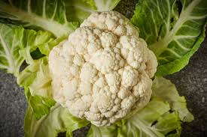
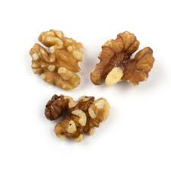
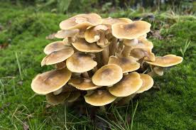
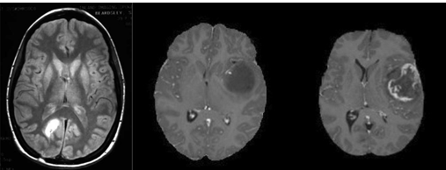
Binary Dataset
Data Collection:
Collected a binary dataset with two classes: MRI or not.
Focused on addressing challenges:
Control Environment Images
Background Influence
Image Preprocessing
Resizing: Standardized all images to
224x224 pixels.
Table 3
Figure 5
Class | Train | Valid | Total
Valid | 213 | 820 | 1033
Not valid | 300 | 1200 | 1500
Figure 6

Slide 24
Multiclass
Dataset includes real-world images to address limitations of controlled environments.
Source: Kaggle
Table 4
Class | Train | Test | Total
No Tumor | 1595 | 405 | 2000
Glioma | 1321 | 300 | 1621
Meningioma | 1339 | 306 | 1645
pituitary | 1457 | 300 | 1757
Total | 5712 | 1311 | 7023

Slide 25
METHODOLOGY

Slide 26
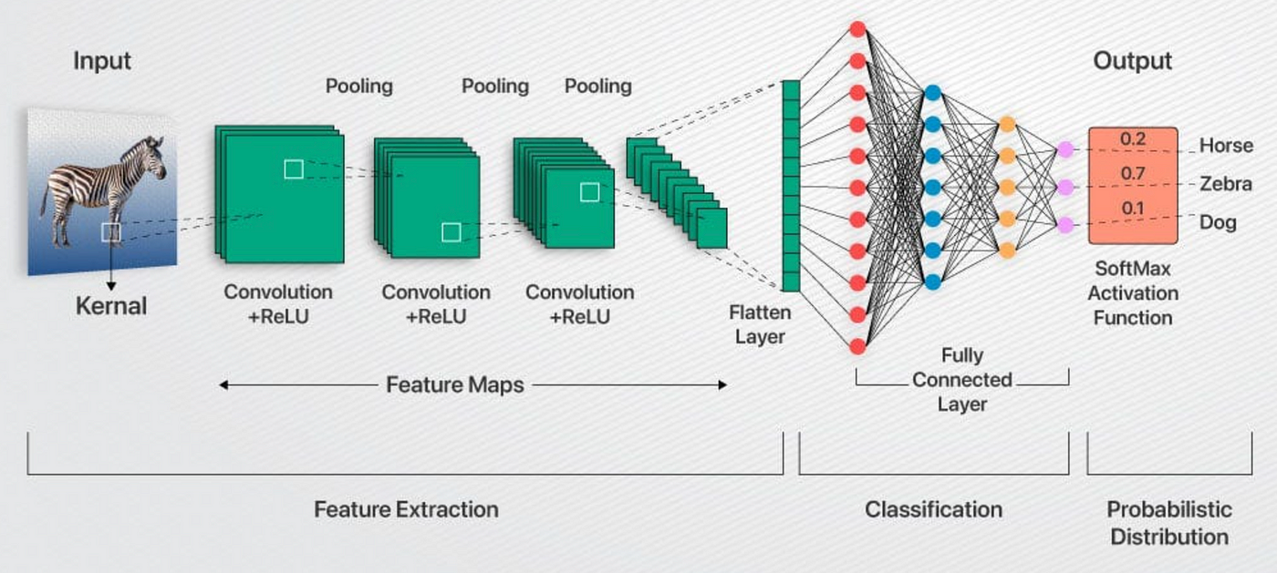
CNN
Glioma
Meningioma
pituitary

Slide 27
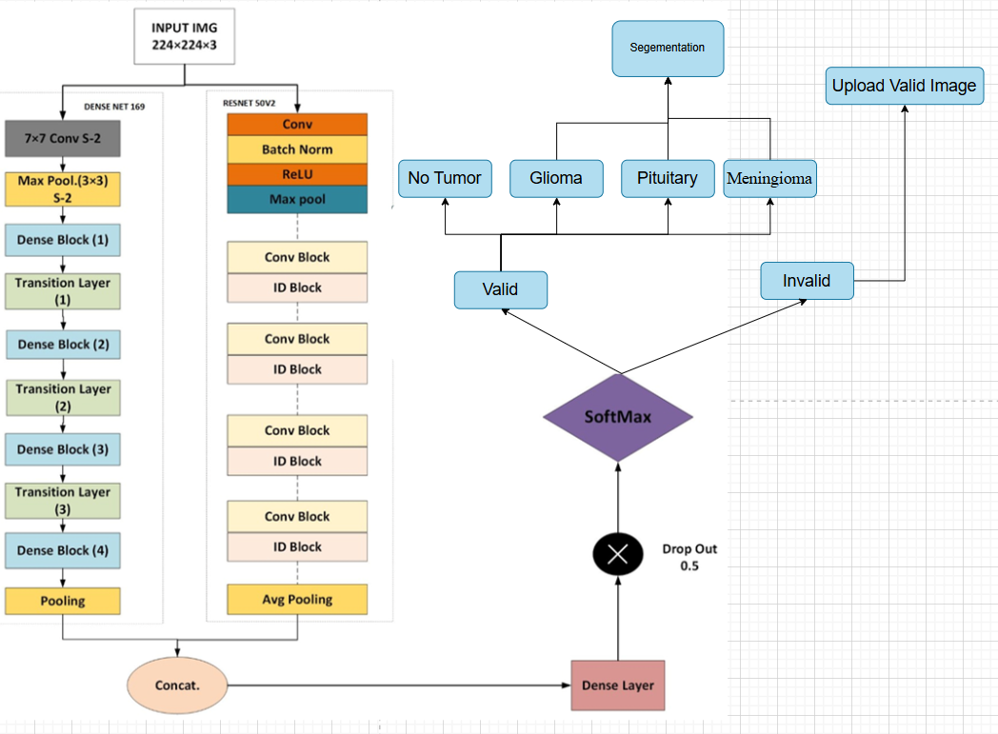
Proposed CNN Architecture

Slide 28
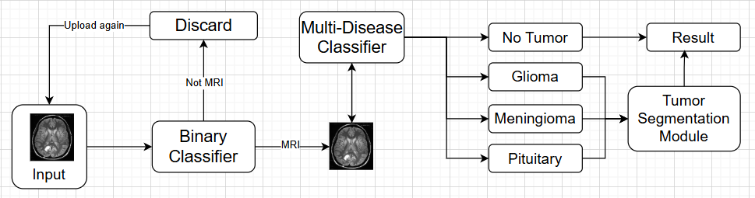
Pipeline Architecture

Slide 29
PROGRESS REPORT SUMMARY

Slide 30
Requirements
List of Different Users:
Admin
Authenticate Doctors.
Manage Profiles (Doctors/Patients)
Doctor
Doctor can Sign up for an account.
Doctor can login.
Doctor can manage appointments.
AI Based Brain Tumor Diagnosis.
Doctor can share report.

Slide 31
Requirements
Patients
Patient can sign up.
Patient can login in.
Patient can Book Appointment.
Patient can share their Mri scan.
Patient can download the report.

Slide 32
Requirements
Use Cases / User Stories:
Use Case 1: Manage Dashboard
Actor: Admin
Description: View Patients/Doctors, and appointment list, add or remove doctors/patients' account.
Use Case 2: Authenticate Doctors
Actor: Admin
Description: View the sign-up request of doctor and accept or reject the sign-up request.

Slide 33
Requirements
Use Case 3: Book Appointment
Actor: Patient
Description: Patient book appointment on available date and time with doctor by seeing their profile.
Use Case 4: Manage profile
Actor: Doctor and Patient
Description: Edit profile details/ change password for their accounts.

Slide 34
Requirements
Use Case 5: Manage Appointment Request
Actor: Doctor
Description: Can accept or reject the appointment request from the patient.
Use Case 6: Access Tumor Vision Ai
Actor: Doctor
Description: Upload the Mri scan and get the quick Ai based diagnosis result.

Slide 35
Requirements
Use Cases / User Stories:
As a patient, I want to be able to search doctors and view their profile for appointment.
As a patient, I want to be able to securely share my Mri scan, so they can provide accurate diagnosis and treatment recommendation.
As a Doctor, I want a calendar view to manage my appointments, so I can efficiently schedule my appointments schedule.

Slide 36
Requirements
Use Cases / User Stories:
As a doctor, I want to securely input images of my patients Mri Scan, so I can effectively diagnose it.
As an Admin, I want to verify the credentials and qualification of doctors during registration process so only qualified professionals can join the platform.

Slide 37
Requirements
Functional Requirements:
Brain Tumor diagnosis through image analysis for doctor and patient.
Profile management for doctor and patients.
Doctors search and detailed profiles for patients.
Appointments booking and reminders for patient.
Access to appointments records for patients and doctor.
Doctor account verification by Admin.
Schedule of appointments daily / weekly for doctor for quickly review.
Accept / reject the appointment request by Doctor.

Slide 38
Requirements
Non-Functional Requirements:
Fast Processing: Detect tumors from MRI scans within 1 minute.
High Performance: Support 100+ users at once without lag or crashes.
User-Friendly: Simple interface usable without technical training.
Auto Backup & Recovery: Daily backups with data recovery.
Device Compatibility: Works smoothly across mobiles, tablets, and desktops.

Slide 39
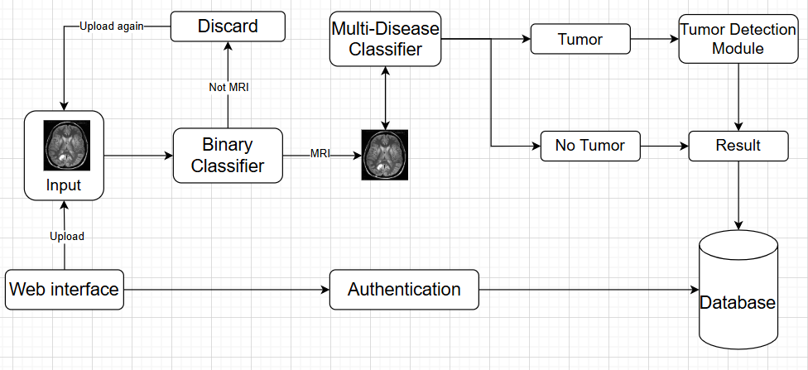
Design
Diagtam -.System Architecture

Slide 40
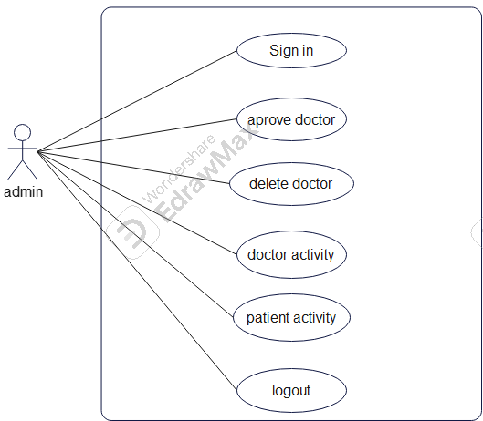
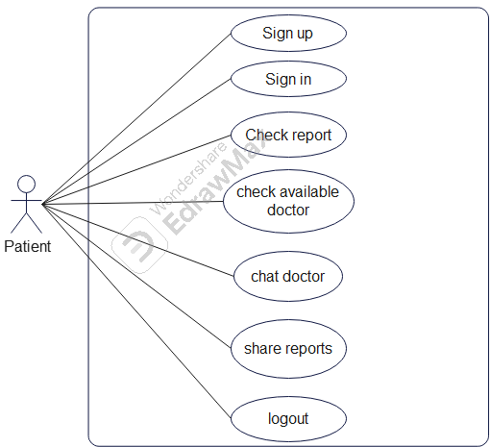
Design
Usecase diagram: Admin Usecase Diagram: Patient

Slide 41
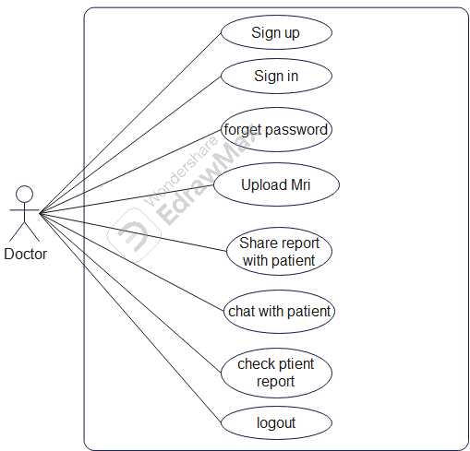
Design
Usecase diagram: Doctor
Check patient report

Slide 42
Implementation[1/3]
List Development Tools & Technologies
ReactJS
Tailwind CSS / BootStrap
Spring Boot (Java)
MongoDB
TensorFlow
Keras
OpenCV
Colab
GitHub

Slide 43
Implementation[2/3]
Best Practices / Coding Standards:
Modular Design: Separate frontend, backend, and AI modules for clarity and scalability.
RESTful APIs: Standard HTTP methods and clear communication between frontend and backend.
Secure Authentication: Role-based login for Admin, Doctor, and Patient with encrypted credentials.
Coding Standards: Consistent naming, proper indentation, comments, and clean structure.
Version Control: GitHub for tracking changes, using branches for new features or fixes.

Slide 44
Implementation[3/3]
Libraries / Components:
Axios React Router Toastify / React-Modal Spring Security Lombok TensorFlow Keras OpenCV NumPy Matplotlib

Slide 45
Experiments and Results Summary[1/3]
Class | TP | FP | FN | TN | Precision % | Recall % | F1 Score %
Glioma | 299 | 0 | 1 | 1011 | 1.0000 | 0.9967 | 0.9983
Meningioma | 306 | 1 | 0 | 1004 | 0.9935 | 1.0000 | 0.9967
No tumor | 405 | 0 | 0 | 906 | 1.0000 | 1.0000 | 1.0000
pituitary | 299 | 0 | 1 | 1011 | 1.0000 | 0.9967 | 0.9983

Slide 46
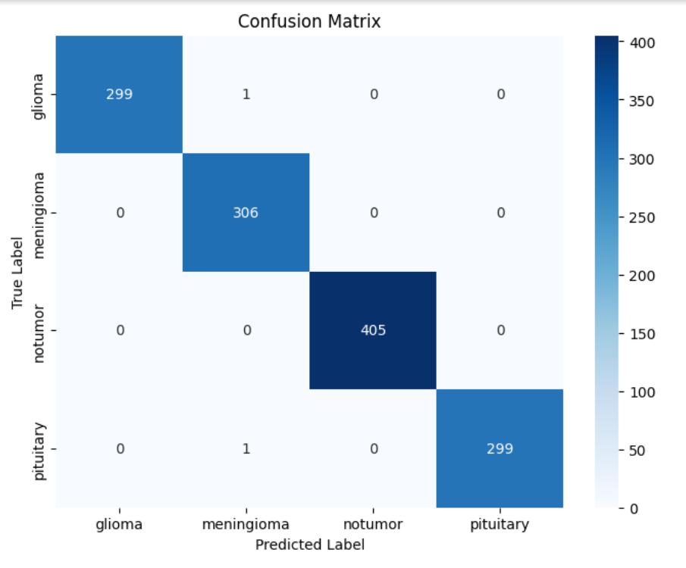
Experiments and Results Summary[2/3]

Slide 47
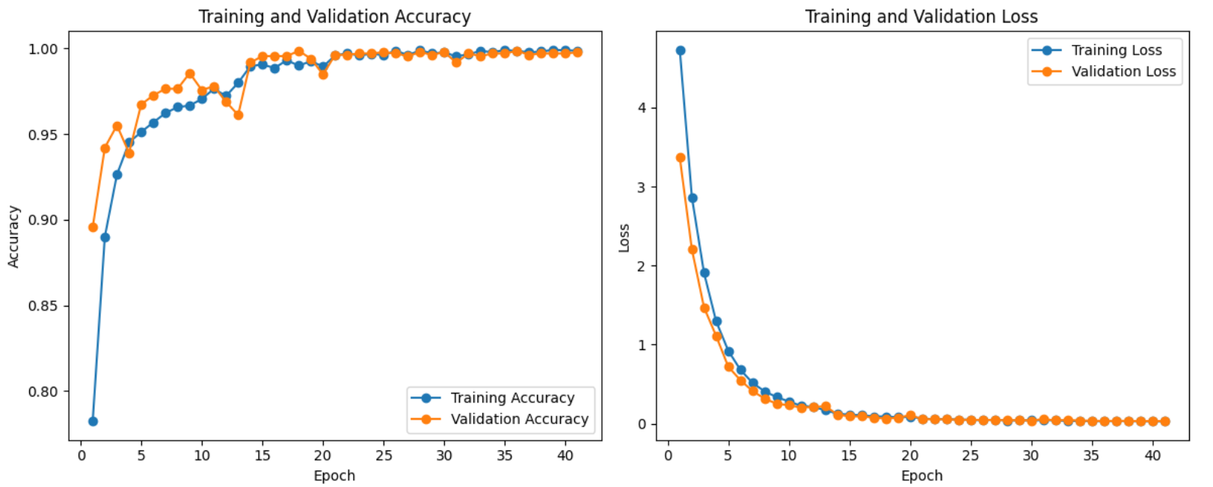
Experiments and Results Summary[2/3]

Slide 48
ENDEAVOUR

Slide 49

Endeavour
Table -
Number | Roles | Sibt E Hassan | Waleed Khalid
1 | Data collection and preprocessing | ✔ | ✔
2 | Front-end development | ✔ | ✔
3 | Back-end Development | ❌ | ✔
4 | Model Development | ✔ | ❌
5 | Model Evaluation | ✔ | ❌
6 | Model integration | ❌ | ✔
7 | Testing and Debugging | ✔ | ✔
8 | Documentation | ✔ | ❌

Slide 50
NEXT STEPS

Slide 51
Work Breakdown Structure (List of all Deliverables / Strikethrough Completed Deliverables)
Major Deliverable 1
Sub Deliverable 1 of 1
Sub Deliverable 2 of 1
Sub Deliverable 3 of 1
. . .
Major Deliverable 2
Sub Deliverable 1 of 2
Sub Deliverable 2 of 2
. . .
Major Deliverable 3
Sub Deliverable 1 of 3
Sub Deliverable 2 of 3
Sub Deliverable 3 of 3
. . .
Major Deliverable 4
. . .

Slide 52
Work Breakdown Structure [1/1] (List of all Deliverables / Strikethrough Completed Deliverables)
Front End Development
UI/UX Design
Web pages
Implementation
Dataset
Dataset Collection
Data Preprocessing
Backend
Backend Implementation
API Development
Algorithm
Model Training
Model Enhancement
Deployment
Model deployment

Slide 53
Challenges
Dataset collection
Data-preprocessing
Model Selection
User Experience

Slide 54
PROTOTYPE & REPORT

Slide 55
Report
Chapter 1: Introduction
Chapter 2: Literature Review / Market Survey
Chapter 3: Requirements and Design
Chapter 4: Implementation and Test Cases
Chapter 5: Experiment Results and Analysis
Chapter 6: Conclusion & Future Direction

Slide 56
REFERENCES

Slide 57
References
[1]R. Tummala, “A Novel Approach to Brain Tumor Classification Using Deep Neural Networks,” Oct. 05, 2023. doi: 10.1101/2023.10.03.23296522.
[2]M. Aamir et al., “Brain Tumor Detection and Classification Using an Optimized Convolutional Neural Network,” Diagnostics, vol. 14, no. 16, Aug. 2024, doi: 10.3390/diagnostics14161714.
[3]G. Balaji, R. Sen, and H. Kirty, “Detection and Classification of Brain tumors Using Deep Convolutional Neural Networks,” Aug. 2022, [Online]. Available: http://arxiv.org/abs/2208.13264
[4]S. Kumar and D. Kumar, “Human brain tumor classification and segmentation using CNN,” Multimed Tools Appl, vol. 82, no. 5, pp. 7599–7620, Feb. 2023, doi: 10.1007/s11042-022-13713-2.
[5]S. A. Nawaz, D. M. Khan, and S. Qadri, “Brain Tumor Classification Based on Hybrid Optimized Multi-features Analysis Using Magnetic Resonance Imaging Dataset,” Applied Artificial Intelligence, vol. 36, no. 1, 2022, doi: 10.1080/08839514.2022.2031824.

